Slide 1
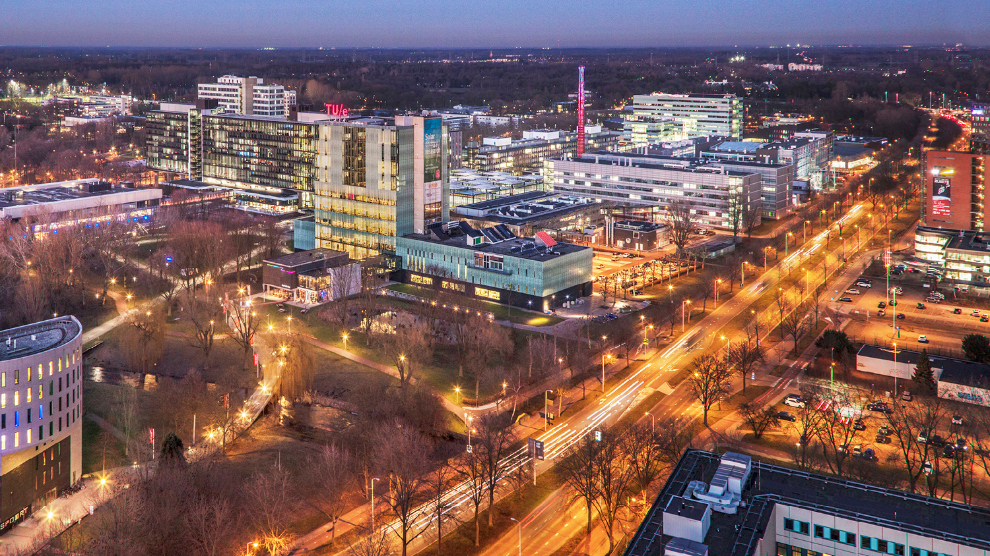
Structure Learning in High-Dimensional Time Series Data
Final project Presentation, 14-07-2022
Martin de Quincey
Mathematics and Computer Science

Slide 2
Table of content
Introduction
Problem Setting
Methodologies
Results
Conclusion
Future Directions

Slide 3

Problem Setting
Based on time series data, learn the structure of a graphical model
Arc $(x, y)$ => $x$ “is useful” in predicting $y$
Inferred structure must be acyclic

Slide 4
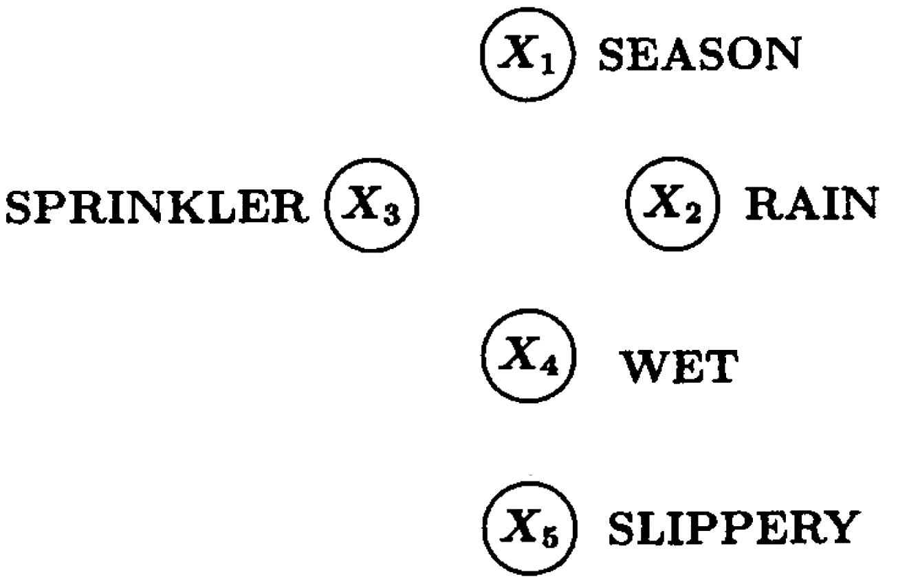



Problem Setting – Example [1]

Slide 5
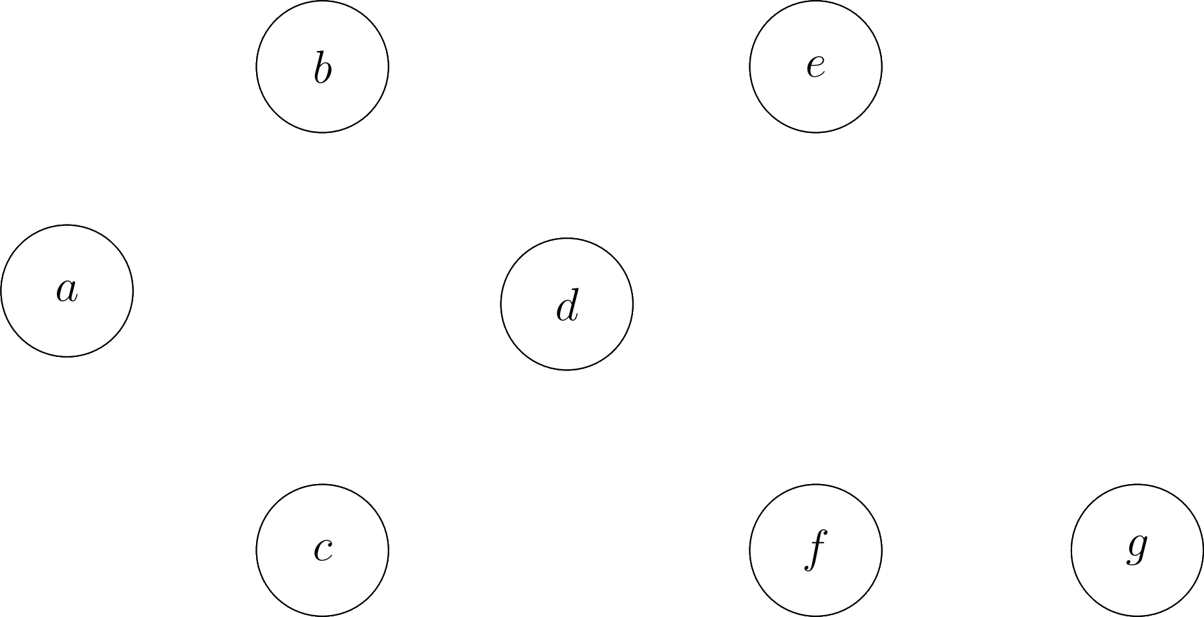
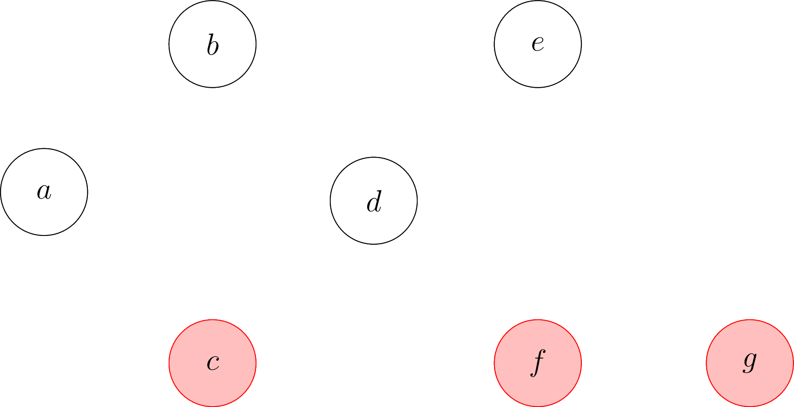

Motivation – Root Cause Analysis in Complex Systems

Slide 6
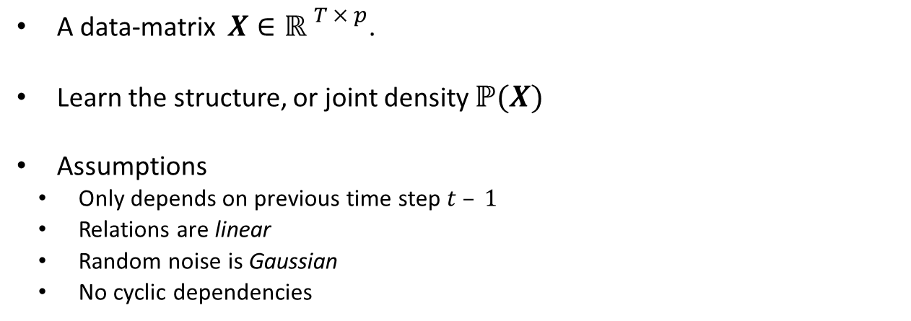
Formal Problem Setting
A data-matrix $X∈{ℝ }^{T × p}$.
Learn the structure, or joint density $ℙ(X)$
Assumptions
Only depends on previous time step $t – 1$
Relations are linear
Random noise is Gaussian
No cyclic dependencies

Slide 7
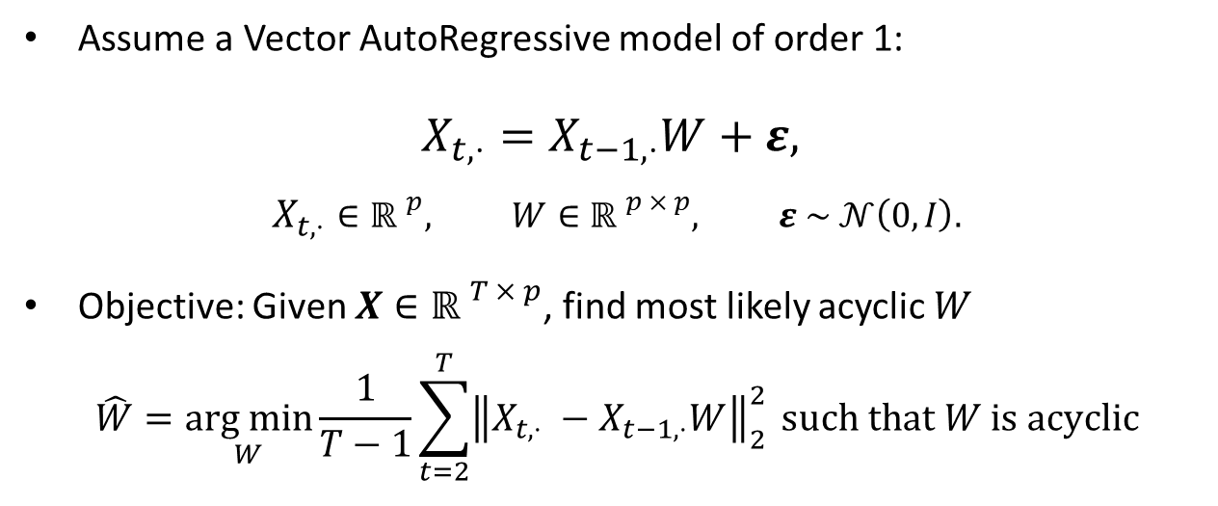
Model
Assume a Vector AutoRegressive model of order 1:
$$X_{t, ⋅}=X_{t−1, ⋅}W+ε,$$
$$X_{t, ⋅}∈{ℝ }^{p}, W∈{ℝ }^{p × p}, ε \sim 𝒩\left(0, I\right).$$
Objective: Given $X∈{ℝ }^{T × p}$, find most likely acyclic $W$
$$\hat{W}=\underset{W}{arg min}{\frac{1}{T−1}\sum_{t=2}^{T}{{\left\|X_{t,⋅} −X_{t−1,⋅}W\right\|}_{2}^{2}}}{ such that W is acyclic }$$

Slide 8
Methodologies
Permutation-Based
Greedy Random Walk
Iterative
Orthogonal Matching Pursuit
Continuous
NOTEARS

Slide 9
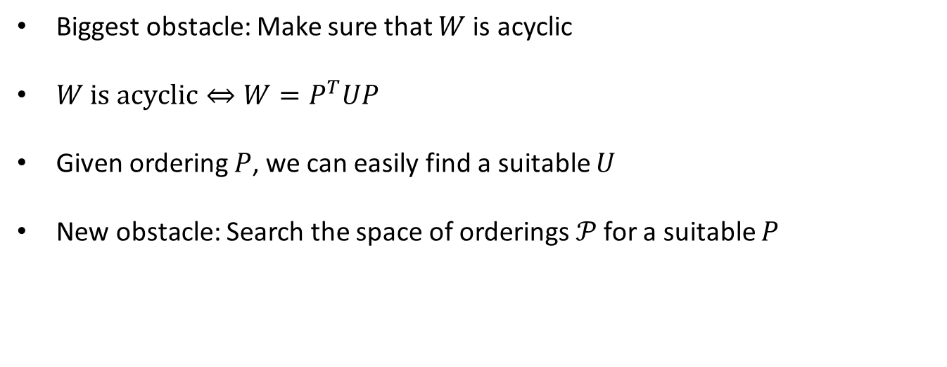
1) Orderings
Biggest obstacle: Make sure that $W$ is acyclic
$W \text{is} \text{a}cyclic⇔{W=P}^{T}UP$
Given ordering $P$, we can easily find a suitable $U$
New obstacle: Search the space of orderings$𝒫$ for a suitable $P$

Slide 10
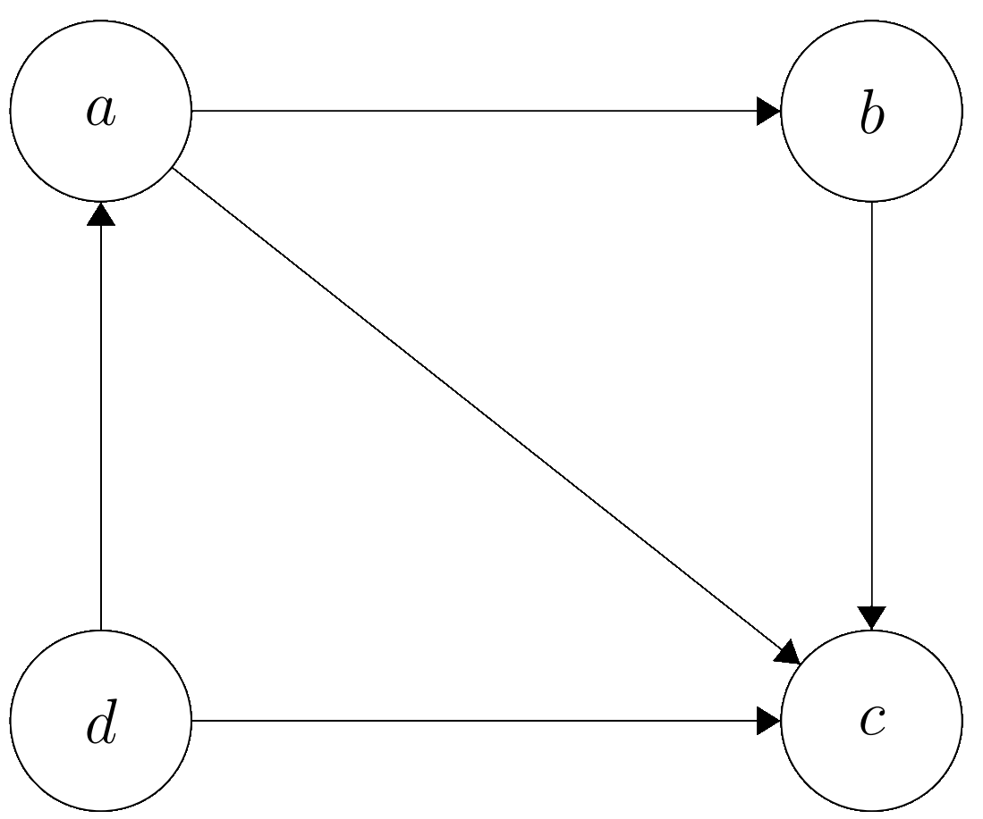
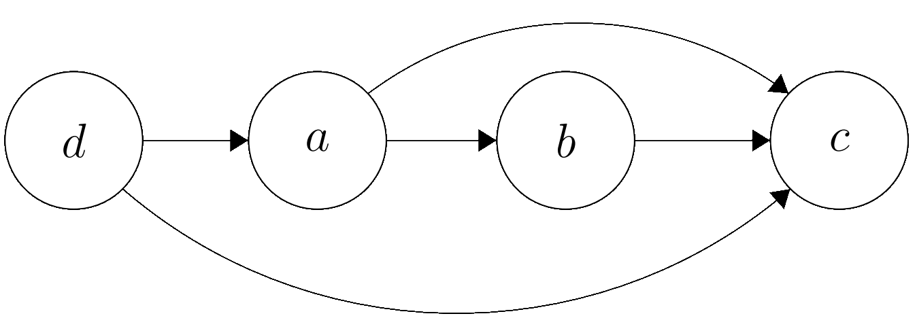

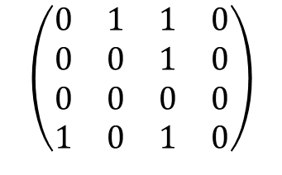

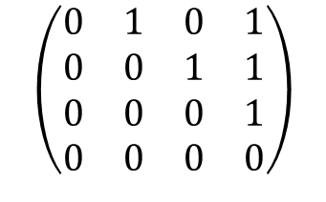


1) Orderings
$$a b c d$$
$$a$$
$$b$$
$$c$$
$$d$$
$$\left(\begin{matrix}0 & 1 & 1 & 0 \\ 0 & 0 & 1 & 0 \\ 0 & 0 & 0 & 0 \\ 1 & 0 & 1 & 0\end{matrix}\right)$$
$$d a b c$$
$$d$$
$$a$$
$$b$$
$$c$$
$$\left(\begin{matrix}0 & 1 & 0 & 1 \\ 0 & 0 & 1 & 1 \\ 0 & 0 & 0 & 1 \\ 0 & 0 & 0 & 0\end{matrix}\right)$$

Slide 11

1) Random Walk
Exhaustively trying all orderings is $𝒪(p!)$
Random walk on the set of orderings
Possible transitions: Swapping two variables in the ordering

Slide 12
1) Greedy Random Walk
Randomly swap the order of two variables
Transition to this new ordering if it achieves a better score
Iterate until time-out

Slide 13
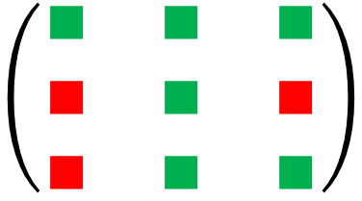
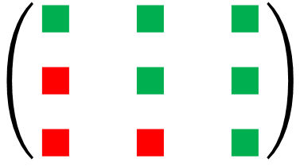

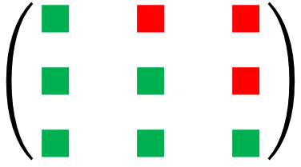
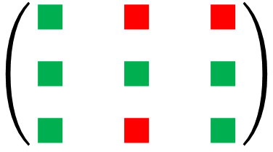
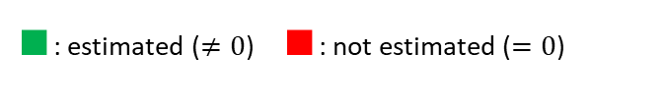
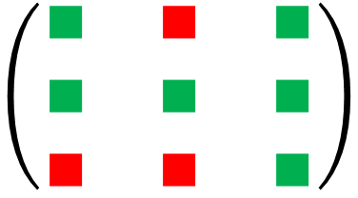

1) Greedy Random Walk
$∎$: estimated ($≠0$) $∎$: not estimated ($=0$)
Ordering $(1, 2, 3).$
Try $(1, 3, 2)$
Try $(2, 1, 3)$
Try $(2, 3, 1)$
Try $(3, 2, 1)$
No improvements found.
$$\left(\begin{matrix}∎ & ∎ & ∎ \\ ∎ & ∎ & ∎ \\ ∎ & ∎ & ∎\end{matrix}\right)$$
$⟹$no improvement.
$⟹$ improvement.
$⟹$ no improvement.
$⟹$ improvement.
$$\left(\begin{matrix}∎ & ∎ & ∎ \\ ∎ & ∎ & ∎ \\ ∎ & ∎ & ∎\end{matrix}\right)$$
$$\left(\begin{matrix}∎ & ∎ & ∎ \\ ∎ & ∎ & ∎ \\ ∎ & ∎ & ∎\end{matrix}\right)$$
$$\left(\begin{matrix}∎ & ∎ & ∎ \\ ∎ & ∎ & ∎ \\ ∎ & ∎ & ∎\end{matrix}\right)$$
$$\left(\begin{matrix}∎ & ∎ & ∎ \\ ∎ & ∎ & ∎ \\ ∎ & ∎ & ∎\end{matrix}\right)$$

Slide 14
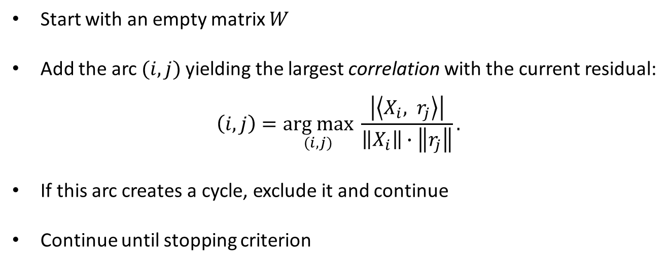
2) Orthogonal Matching Pursuit
Start with an empty matrix $W$
Add the arc $(i, j)$yielding the largest correlation with the current residual:
$$\left(i, j\right)=\underset{(i, j)}{arg max}{\frac{\left|\left\langle X_{i}, r_{j}\right\rangle \right|}{\left\|X_{i}\right\|∙\left\|r_{j}\right\|}}.$$
If this arc creates a cycle, exclude it and continue
Continue until stopping criterion

Slide 15
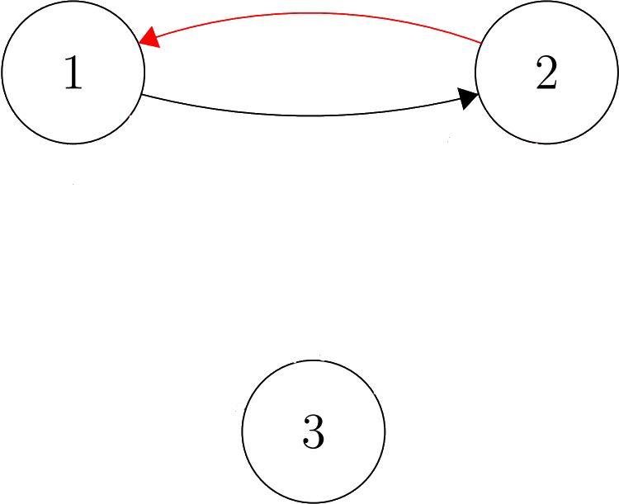
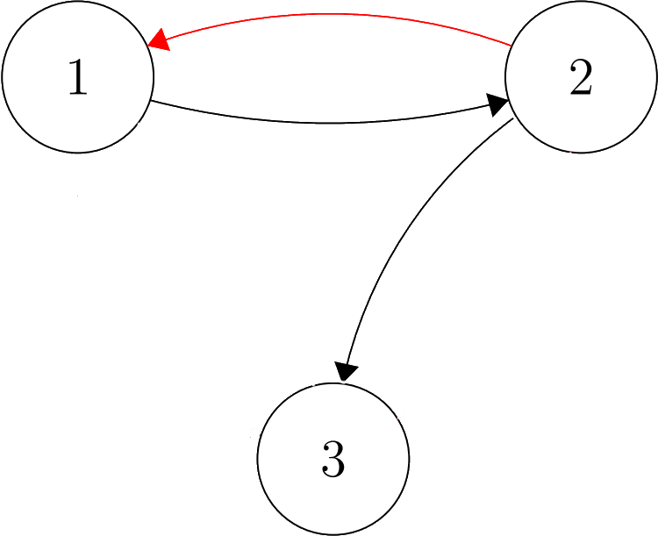
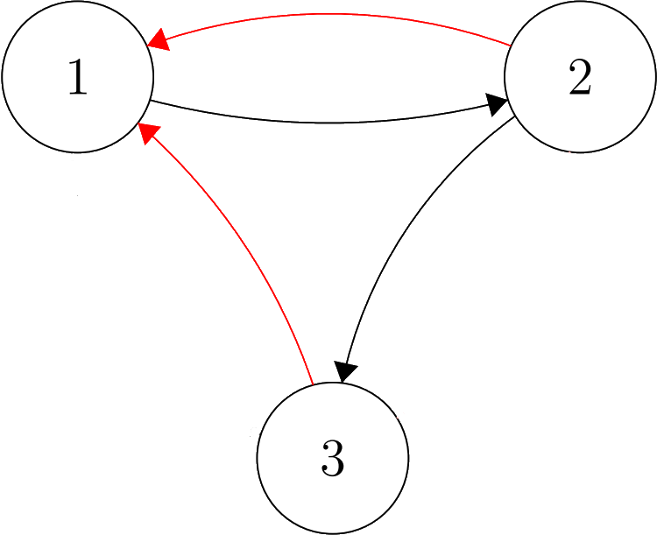
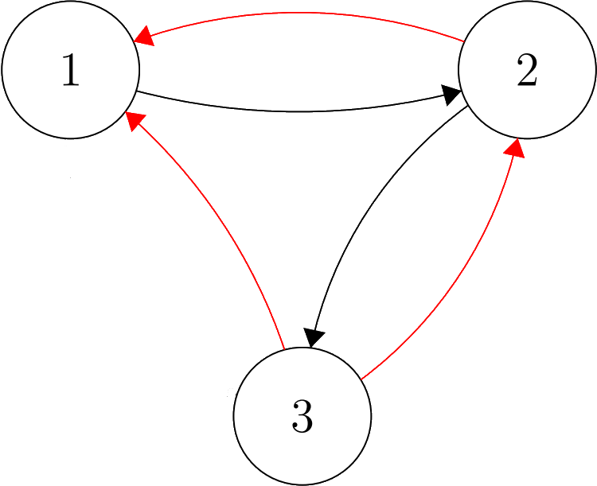
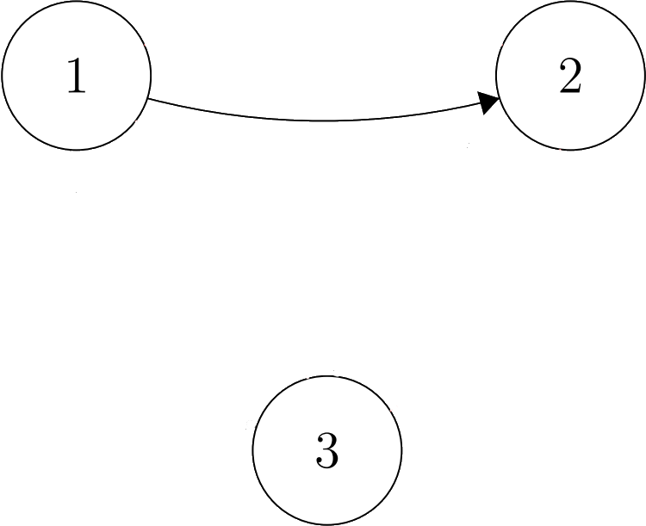

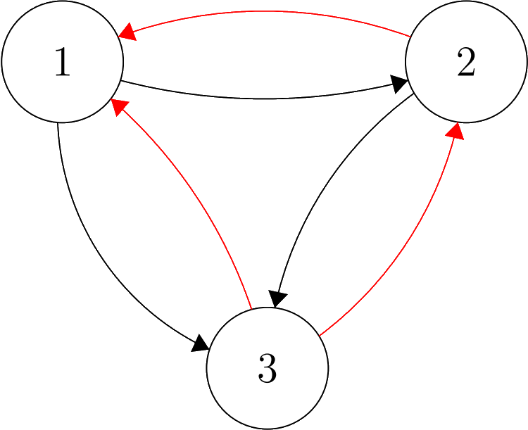
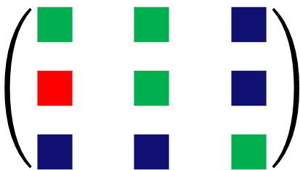

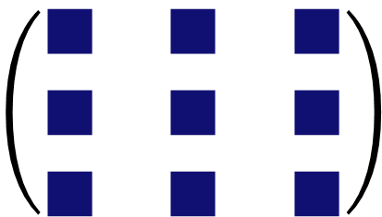
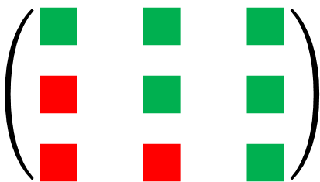
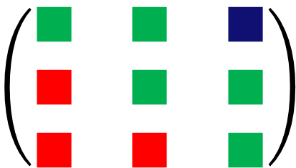
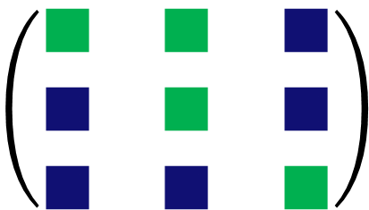
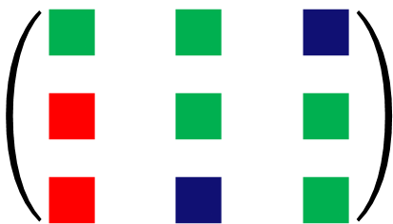
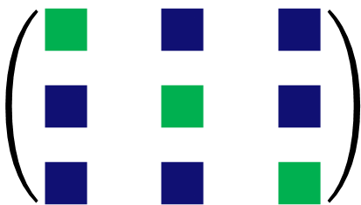
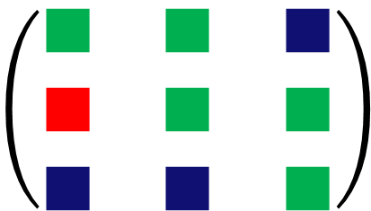
2) Orthogonal Matching Pursuit
1 4 9
5 2 6
7 8 3
1 4 9
5 2 6
7 8 3
1 4 9
5 2 6
7 8 3
1 4 9
5 2 6
7 8 3
1 4 9
5 2 6
7 8 3
1 4 9
5 2 6
7 8 3
1 4 9
5 2 6
7 8 3
1 4 6
5 2 5
7 8 3
$$\left(\begin{matrix}∎ & ∎ & ∎ \\ ∎ & ∎ & ∎ \\ ∎ & ∎ & ∎\end{matrix}\right)$$
$$\left(\begin{matrix}∎ & ∎ & ∎ \\ ∎ & ∎ & ∎ \\ ∎ & ∎ & ∎\end{matrix}\right)$$
$$\left(\begin{matrix}∎ & ∎ & ∎ \\ ∎ & ∎ & ∎ \\ ∎ & ∎ & ∎\end{matrix}\right)$$
$$\left(\begin{matrix}∎ & ∎ & ∎ \\ ∎ & ∎ & ∎ \\ ∎ & ∎ & ∎\end{matrix}\right)$$
$$\left(\begin{matrix}∎ & ∎ & ∎ \\ ∎ & ∎ & ∎ \\ ∎ & ∎ & ∎\end{matrix}\right)$$
$$\left(\begin{matrix}∎ & ∎ & ∎ \\ ∎ & ∎ & ∎ \\ ∎ & ∎ & ∎\end{matrix}\right)$$
$$\left(\begin{matrix}∎ & ∎ & ∎ \\ ∎ & ∎ & ∎ \\ ∎ & ∎ & ∎\end{matrix}\right)$$
$$\left(\begin{matrix}∎ & ∎ & ∎ \\ ∎ & ∎ & ∎ \\ ∎ & ∎ & ∎\end{matrix}\right)$$
$∎$: not decided yet
$∎$: estimated ($≠0$)
$∎$: not estimated ($=0$)

Slide 16

2) Selecting a suitable number of arcs
Iterative approaches constructs $W$ one arc per iteration
The gain in predictive performance decreases as we add more arcs
When does adding an arc not yield sufficient gain anymore?

Slide 17
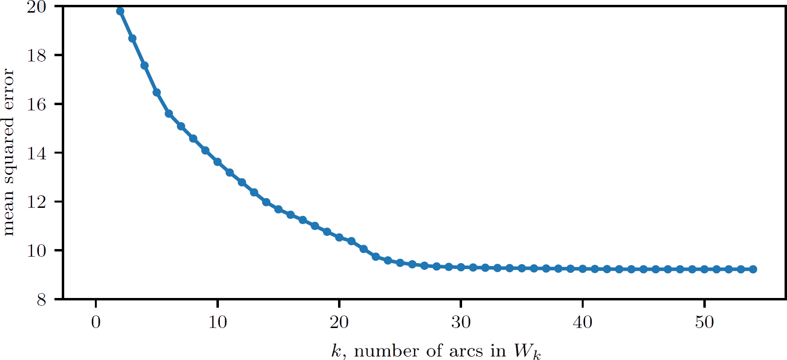
2) Selecting a suitable number of arcs

Slide 18
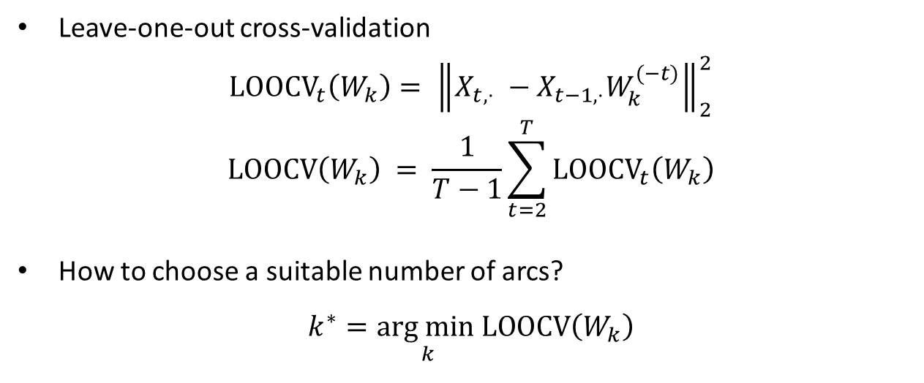
2) Selecting a suitable number of arcs
Leave-one-out cross-validation
$$LOOCV_{t}\left(W_{k}\right)= {\left\|X_{t,⋅} −X_{t−1,⋅}W_{k}^{(−t)}\right\|}_{2}^{2}$$
$$LOOCV\left(W_{k}\right) = \frac{1}{T−1}\sum_{t=2}^{T}{LOOCV_{t}\left(W_{k}\right)}$$
How to choose a suitable number of arcs?
$$k^{∗}=\underset{k}{arg min}LOOCV\left(W_{k}\right)$$

Slide 19
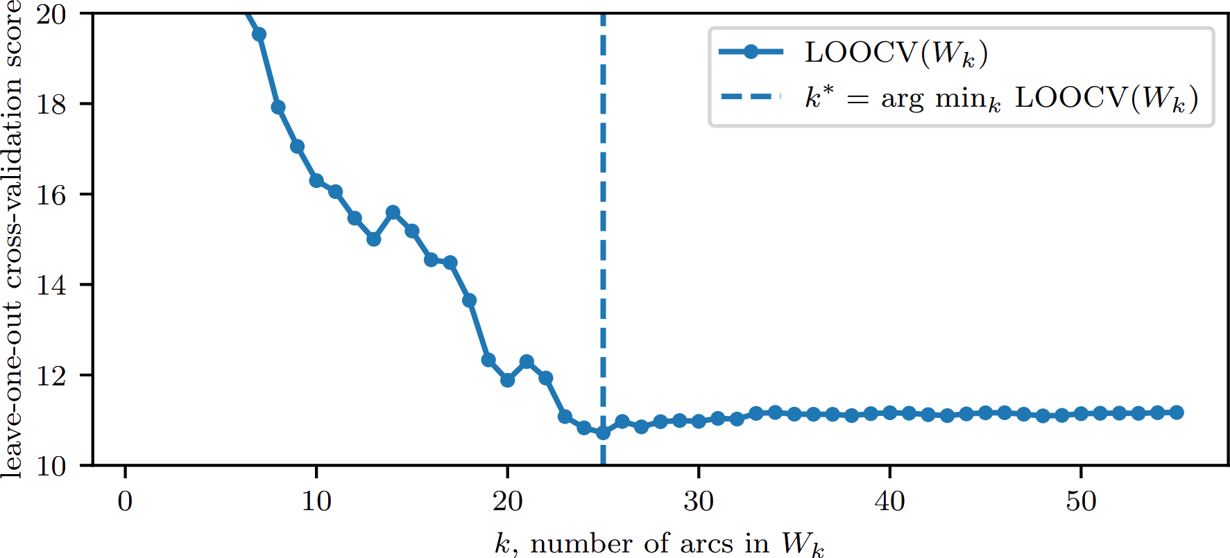
2) Selecting a suitable number of arcs

Slide 20

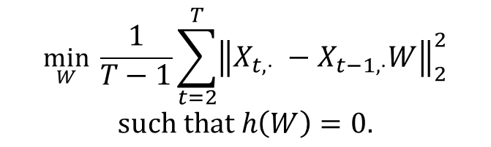
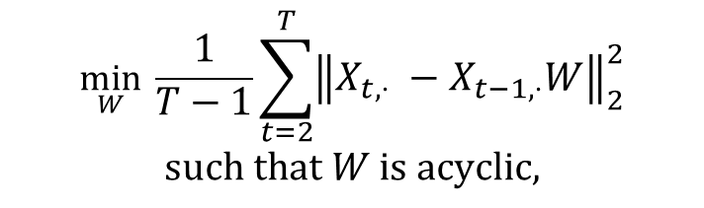
3) NOTEARS
Paper from 2015 by Xun Zheng et al. [2]
Translated the problem from
$h(W) = 0 ⟺ W$ is acyclic.
$$\min_{W} \frac{1}{T−1}\sum_{t=2}^{T}{{\left\|X_{t,⋅} −X_{t−1,⋅}W\right\|}_{2}^{2}}$$
$$such that W is acyclic,$$
$$\min_{W} \frac{1}{T−1}\sum_{t=2}^{T}{{\left\|X_{t,⋅} −X_{t−1,⋅}W\right\|}_{2}^{2}}$$
$$such that h\left(W\right)=0.$$
to

Slide 21
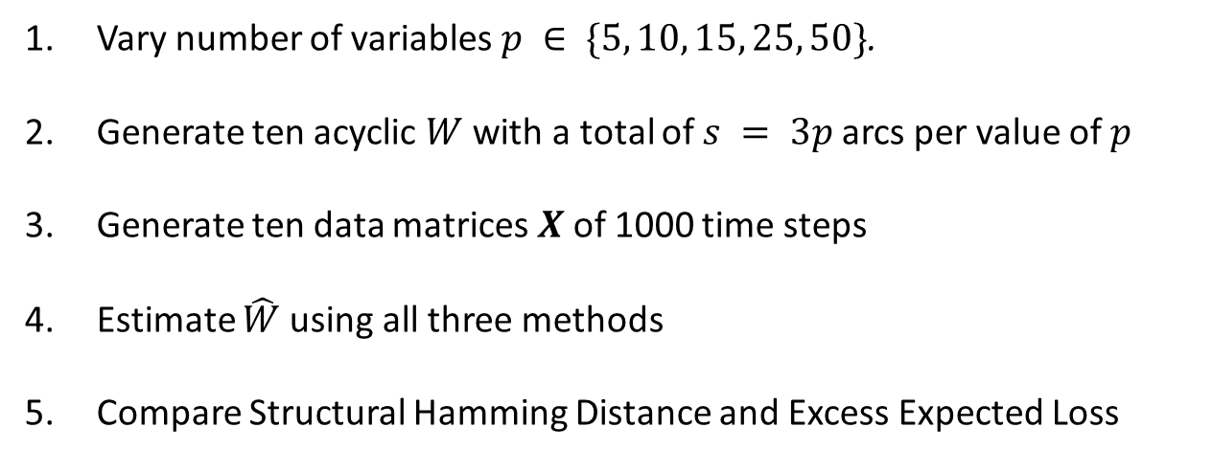
Experimental Results
Vary number of variables $p ∈ \{5, 10, 15, 25, 50\}$.
Generate ten acyclic $W$ with a total of $s = 3p$arcs per value of $p$
Generate ten data matrices $X$ of 1000 time steps
Estimate $\hat{W}$ using all three methods
Compare Structural Hamming Distance and Excess Expected Loss

Slide 22
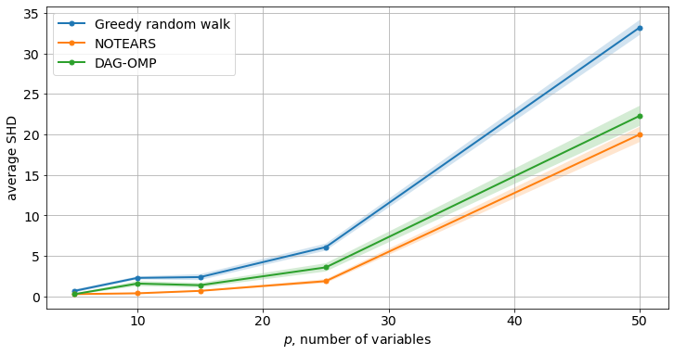
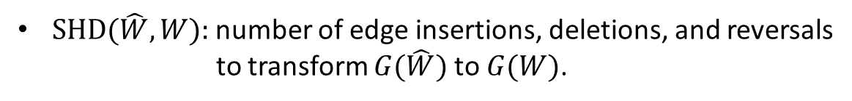
Structural Hamming Distance
$\text{SHD}(\hat{W}, W):$number of edge insertions, deletions, and reversals to transform $G(\hat{W})$ to $G(W)$.

Slide 23
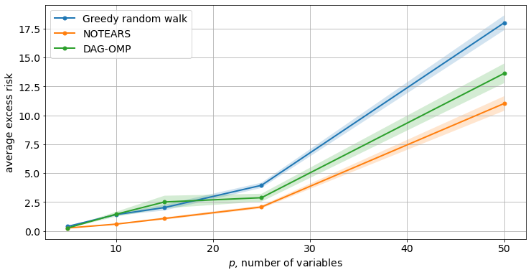
Expected Excess Risk

Slide 24
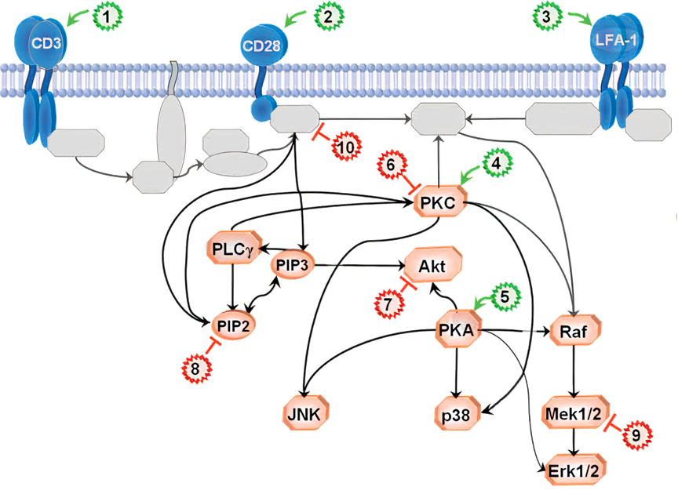
Recovering causal pathways using structure learning

Slide 25
Recovering causal pathways using structure learning
Method | Predicted arcs | TP (out of 20) | SHD | Empirical Risk
Random Walk | 13 | 6 | 21 | 5.037
Regular MH | 15 | 7 | 21 | 5.051
Greedy MH | 17 | 8 | 21 | 4.998
NOTEARS | 16 | 8 | 22 | 5.032
DAG-OMP | 17 | 8 | 21 | 5.000
DAG-OLS-V | 14 | 7 | 20 | 5.156

Slide 26
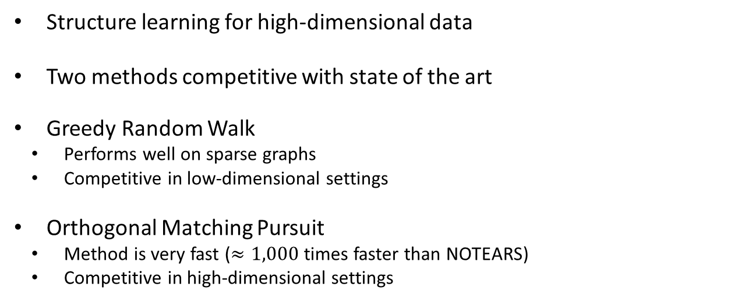
Conclusions
Structure learning for high-dimensional data
Two methods competitive with state of the art
Greedy Random Walk
Performs well on sparse graphs
Competitive in low-dimensional settings
Orthogonal Matching Pursuit
Method is very fast ($≈1,000$ times faster than NOTEARS)
Competitive in high-dimensional settings

Slide 27
Future Directions
Extending the model
Investigate regularization
Statistical guarantees

Slide 28
References
wwwwwwwwwwww
[1] Pearl, J. (1997). Causality: Models, Reasoning, and Inference, Second Edition, p.15 .
[2] Zheng, X., Aragam, B., Ravikumar, P., Xing, E. (2018) DAGs with NO TEARS: Continuous Optimization for Structure Learning. Proceedings of the 32nd International Conference on Neural Information Processing Systems. p.9492-9503.

Slide 29

2) Selecting a suitable number of arcs

